Slide 1
Spam Message Prediction by Using Machine Learning and LLM
Data Scientist: Ng Soo Kuan

Slide 2
Agenda
Business Problem & Understanding
Proposed Analytic Solutions
Text Pre-Processing & EDA
Text Classification by Using Machine Learning
Further Text Classification and Explanation by Using LLM
Conclusion
Limitations & Recommendation

Slide 3
Business Problems and Understanding
Spam messages have significant negative impacts, including financial losses from malware and scams, operational disruptions to businesses, reputational damage to businesses and substantial drain on IT resources & time.
Government want to co-operate with telco services to reduce the reported cases related to spam messages.
Moreover, government wish to raise awareness among citizens.

Slide 4
Proposed Analytic Solutions
Messages
Predict Spam messages by using machine learning
Spam messages further analyze by LLM.
Provide inform decisions to users that messages belong to Spam message

Slide 5
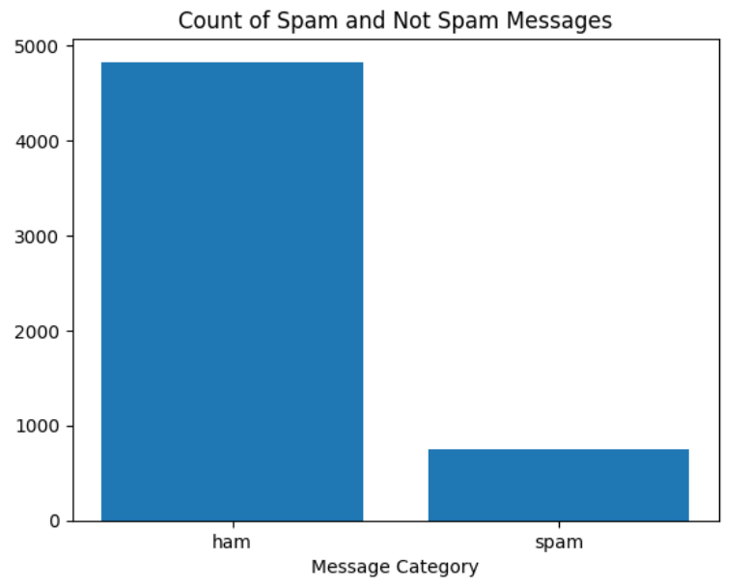
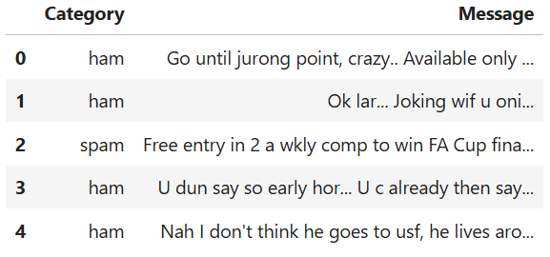
Text Pre-Processing and EDA
Total 5572 messages with Spam label.
Total count of Spam message vs Not Spam (ham)

Slide 6
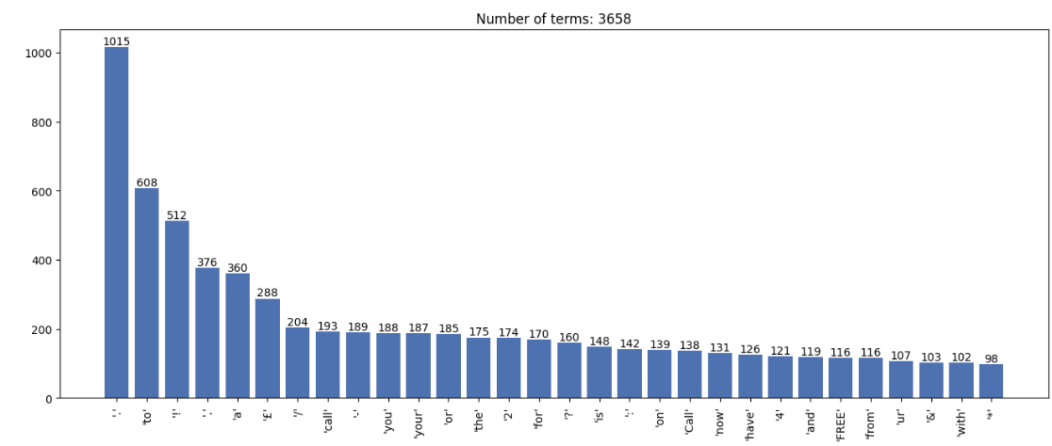
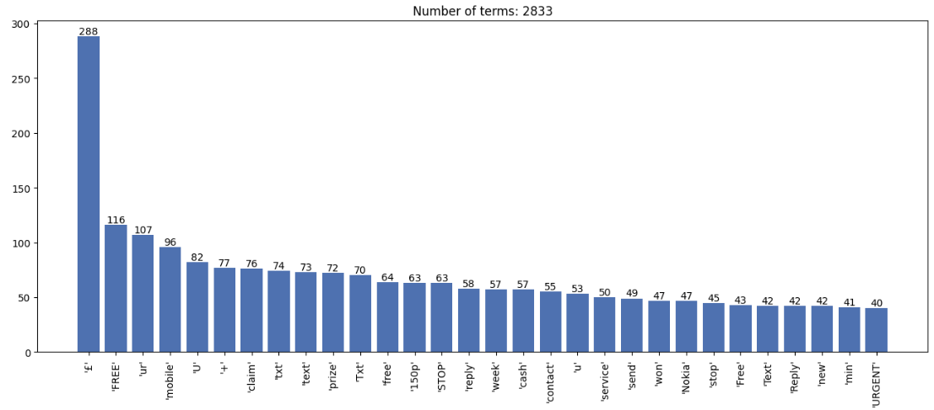
Text Pre-Processing and EDA
Visualize the word frequency of SPAM message
Visualize the word frequency of SPAM message after remove stopwords, punctuation, digit.

Slide 7
Text Pre-Processing and EDA
Split dataset to train and test
Reduce the spaces and new lines to only 1
Remove Stop words, punctuation and digits
Lemmatization in lower case form
Convert Bag-of-Words and TF-IDF.

Slide 8
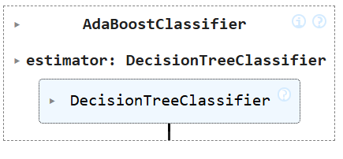
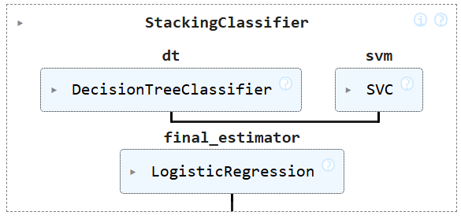
Text Classification by using machine learning
Model | Accuracy
Boosting with Bag of Words | 0.8906
Boosting with TF-IDF | 0.8906
Stacking with Bag of Words | 0.9578
Stacking with TF-IDF | 0.9821
Stacking model selected for text classification. Recall metrics (Out of all the Actual SPAM messages, how many percentage it can predicted as SPAM) will be use to select either bag of words or TD-IDF will be selected for text pre-processing.

Slide 9
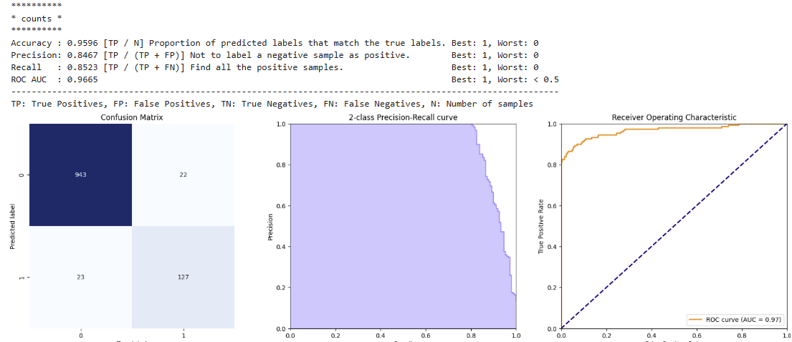
Text Classification by using machine learning
Construct Stacking with Bag of Words pipeline. Recall: 0.8523

Slide 10
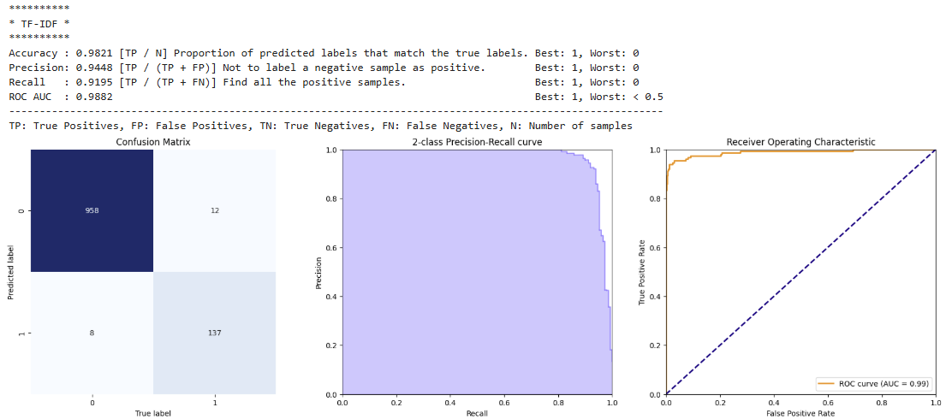
Text Classification by using machine learning
Construct Stacking with TF-IDF pipeline. Recall: 0.9195 (This model will be choosing for Spam Classifier)

Slide 11
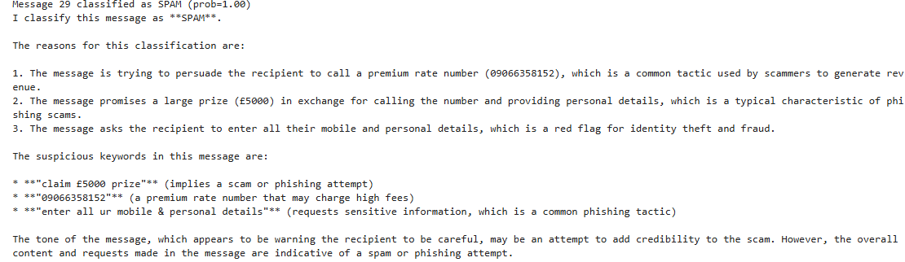
Further Text Classification and Explanation by Using LLM
Further analyse the messages to determine whether belong to SPAM and provide reasons explanation/highlight keywords to raise awareness. Using LLM model “llama-3.3-70b-versatile”
Example:

Slide 12
Conclusion
First layer of SPAM message prediction can be achieve by using Stacking model with TF-IDF Vectorizer (Recall = 0.9195).
LLM can be implemented on second layer to predict the SPAM messages. It can provide explanation and suspicious keywords of suspicious SPAM messages.
Machine learning and LLM able to help filter/reduce SPAM messages and provide explanation to users for SPAM messages. It will help to reduce negative impacts due SPAM messages.

Slide 13
limitations And Recommendations
Current model train on the text in English, the SPAM messages may be consist of different languages. May need gathers the SPAM messages that consist of different languages.
Suggest deploy pilot model on system and monitor the performances on phone text messages.
Once the model achieve good result, it can train on text messages on mails.
Continue monitor users feedback after deploy the model and monitor the reported cases due to SPAM messages.

Slide 14
Reference
https://www.kaggle.com/code/khotijahs1/using-lstm-for-nlp-text-classification/input

